Slide 1
Real Estate Sales Analysis 2001-2020GL
OLAGBAJA BABATUNDE ABIDEEN

Slide 2
Background of the study
Background The Office of Policy and Management maintains a listing of all real estate sales with a sales price of $2,000 or greater that occur between October 1 and September 30 of each year. For each sale record, the file includes town, property address, date of sale, property type (residential, apartment, commercial, industrial, or vacant land), sales price, and property assessment.
Problem Statement: Exploring Property Assessment and Sales Data for Informed Decision-Making.

Slide 3
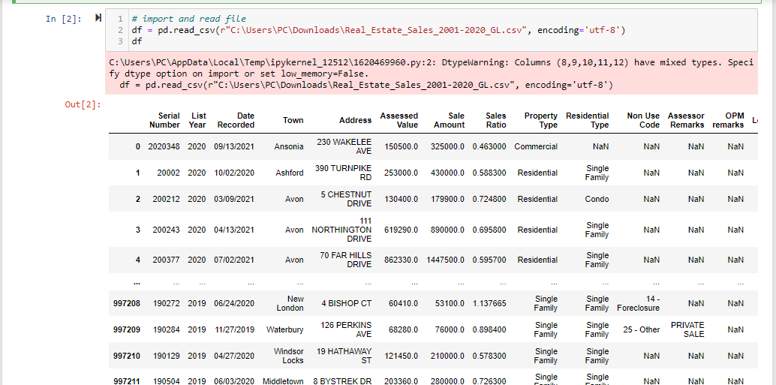
Importation of the data set

Slide 4
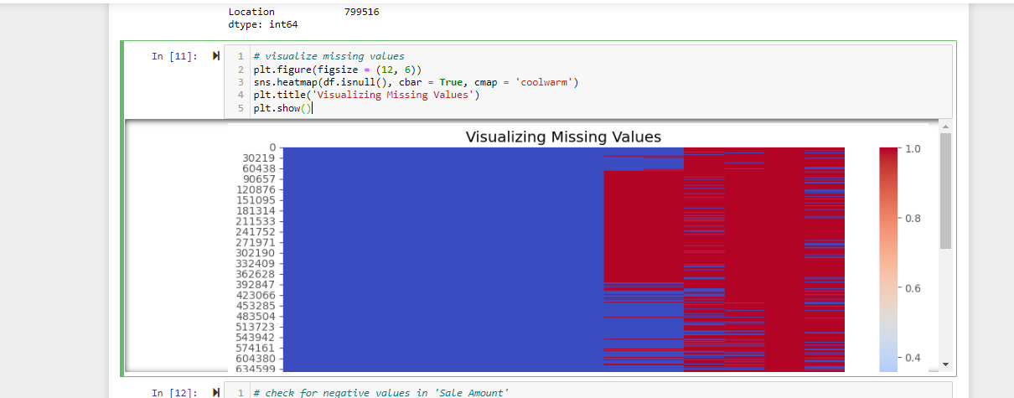
Check and visualization of missing values

Slide 5
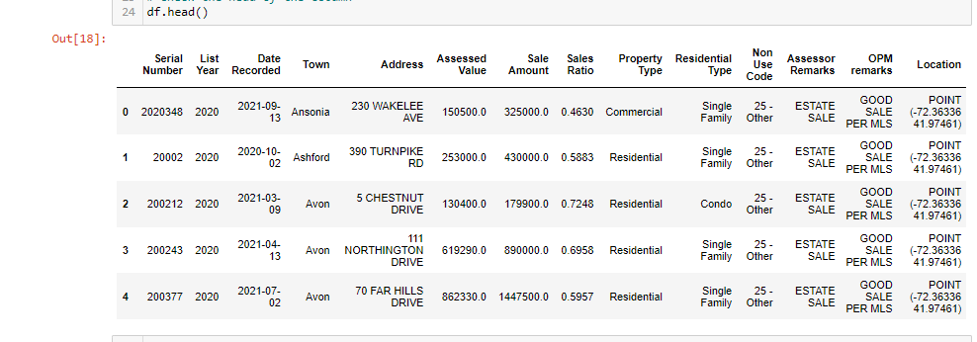
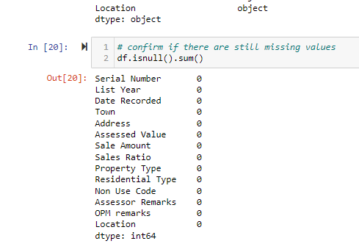
Cleaned data set

Slide 6
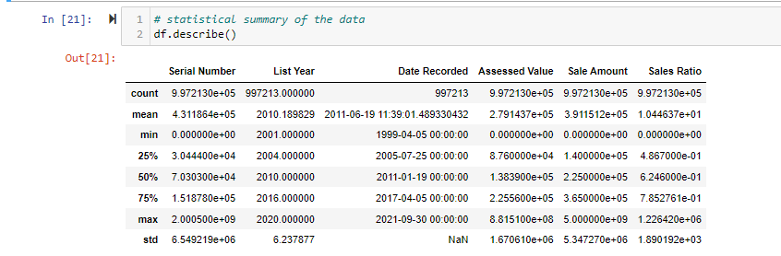
Exploratory Data Analysis

Slide 7
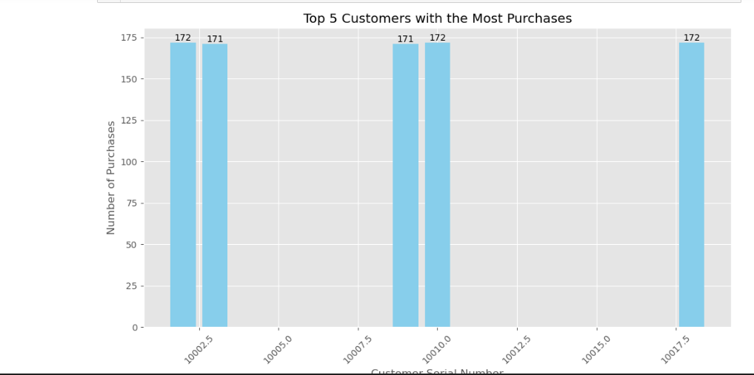
Top 5 customers with the most purchases

Slide 8
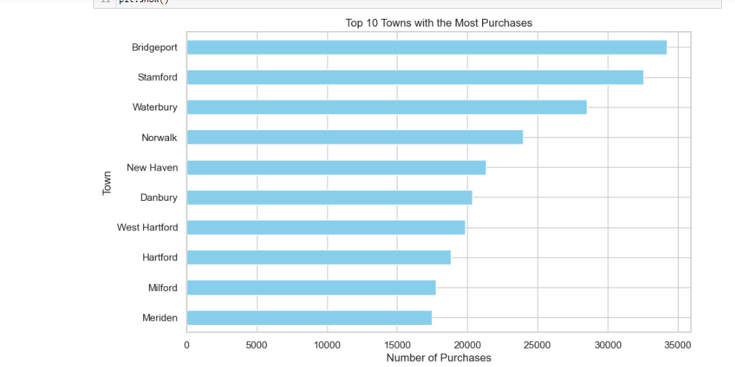
Top 10 Town with the most purchases

Slide 9
Properties with sales ratio significantly above and below 1
The above shows properties with sales ratios significantly above or below 1 and we can observe that Properties with sales ratios significantly above 1 (potential over-assessment): These properties have sales ratios greater than the threshold 1, suggesting that they might be over-assessed. which means that the assessed value of the property is higher than its actual sale amount, leading to potentially higher property taxes for the owners. For example, property with serial number 2020180 in Berlin has an assessed value of 234,200 and a sale amount of 130,000, resulting in a sales ratio of 1.8015, which is significantly above the threshold.
Also for those less than 1 Properties with sales ratios significantly below 1 (potential under-assessment): These properties have sales ratios less than the inverse of the threshold 1, indicating that they might be under-assessed. Which means that the assessed value of the property is lower than its actual sale amount, potentially resulting in lower property taxes for the owners. For example, property with serial number 2020348 in Ansonia has an assessed value of 150,500 and a sale amount of 325,000, resulting in a sales ratio of 0.463, which is significantly below the threshold. As a result, this will help us identify properties that may need reassessment to ensure fairness and accuracy in property taxation.

Slide 10
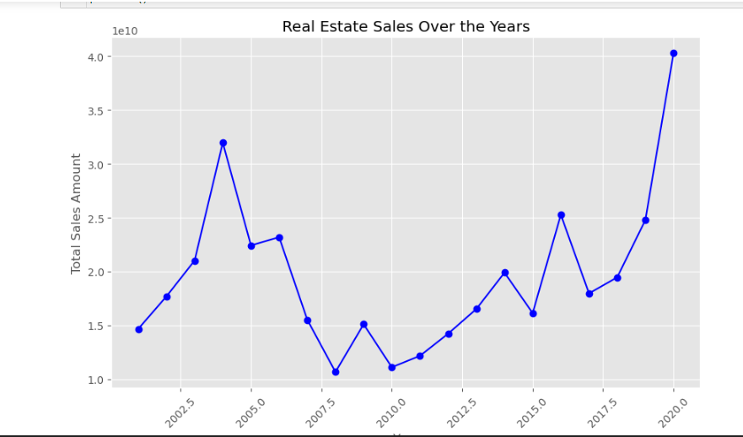
Real estate sales over the year

